Slide 1
ENZYMES

Slide 2
Enzymes
Enzymes are:
Biological catalysts – they speed up chemical reactions but are unchanged by the reaction they catalyse. These reactions either build up bigger molecules (substrate) OR break substrate molecules down.
They work by lowering the activation energy of the reaction.

Slide 3
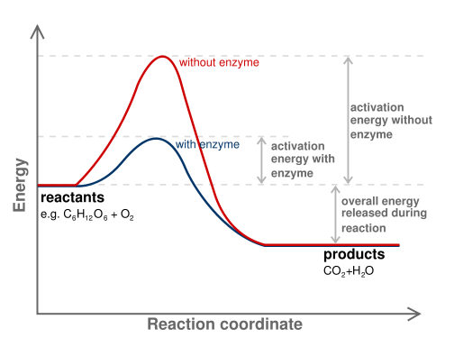
A catalysed reaction
Overall energy is the same with or without the enzyme

Slide 4
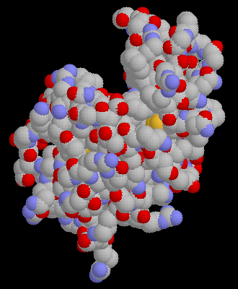
Enzyme Structure
Active Site
Enzyme

Slide 5
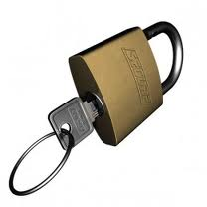
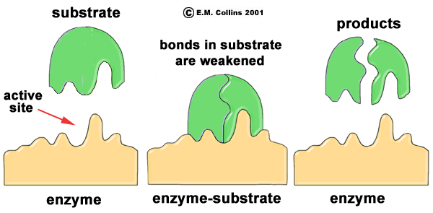
Enzymes are: (continued)
Thought to work by the “lock and key method”.

Slide 6
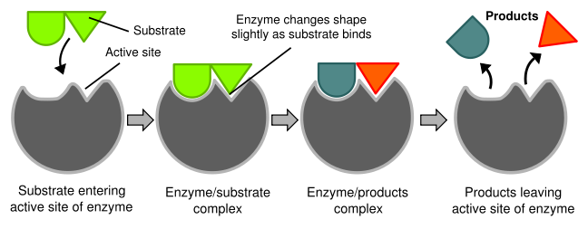
Enzymes are: (continued)
This idea has been modified to the induced fit model of enzyme function.
VIDEO

Slide 7
Enzymes are: (continued)
Specific - Each enzyme will catalyse only one reaction.
e.g. Sucrase will break down sucrose and nothing else.

Slide 8
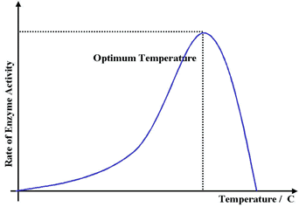
Enzymes are: (continued) ,
Affected by temperature
Action is slow at low temperature.
It speeds up as temp. increases
Reaches an optimum (e.g. 37°C)
Declines with high temps.
Stops when enzyme is denatured.

Slide 9
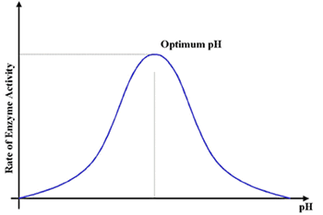
Enzymes are: (continued) ,
pH dependent
Have a specific pH at which they work best.

Slide 10
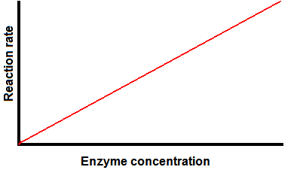
Enzymes are: (continued) ,
Affected by enzyme concentration.
The greater the enzyme concentration, the faster the reaction

Slide 11
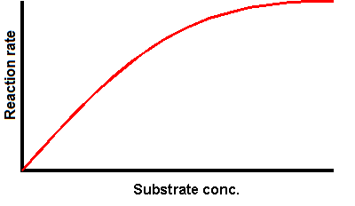
Enzymes are: (continued) ,
Also affected by substrate concentration.
The greater the substrate concentration, the faster the reaction, BUT it slows as all the enzyme molecules become engaged.

Slide 12
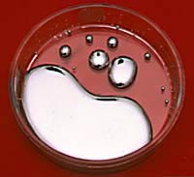
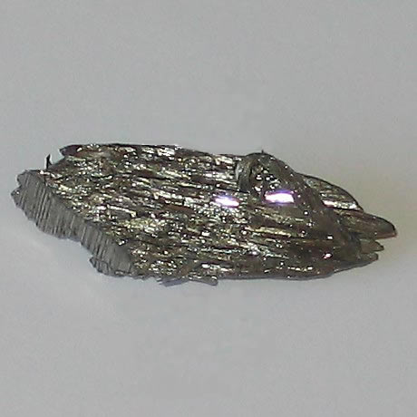
Enzymes are: (continued)
9. Poisoned by substances such as heavy metal ions, e.g mercury and lead.

Slide 13
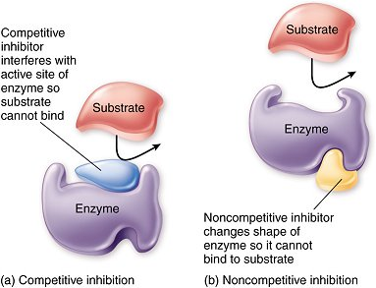
How Inhibitors Work

Slide 14
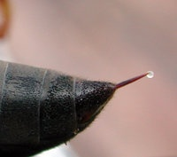
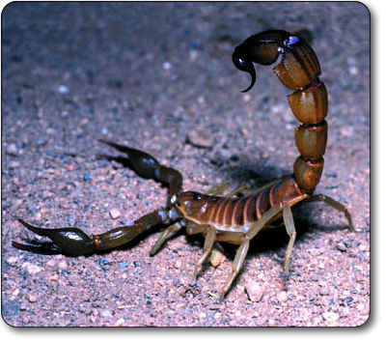
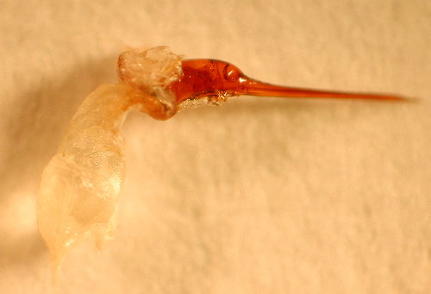
Enzymes are: (continued)
10. Sometimes poisons themselves!
E.g. stings
Wasp
Scorpion
Bee

Slide 15
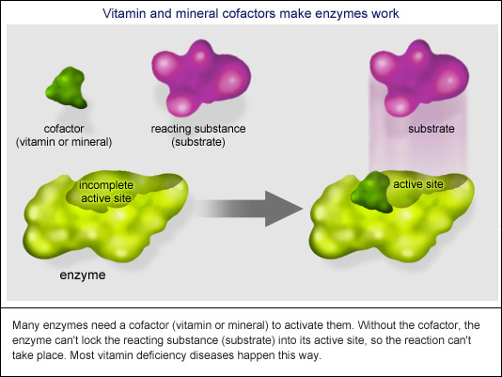
Enzymes: (continued) ,
11. Often have co-factors
e.g. metals such as iron or magnesium
or organic co-enzymes (e.g. vitamins)

Slide 16
